Slide 1
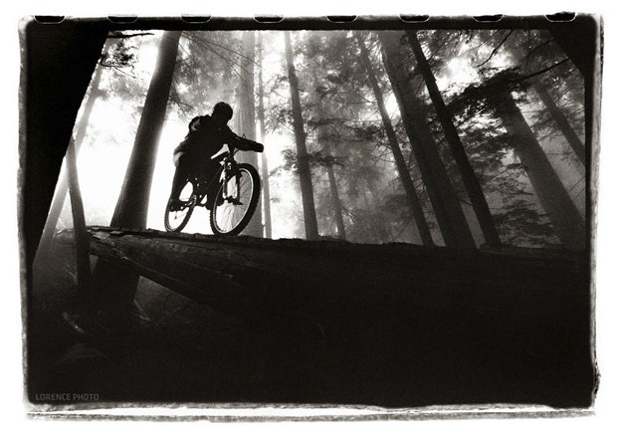
Mountain Bike (MTB) Analysis
Mike Czerwinski & Justin Schulberg

Slide 2
Project Overview

Slide 3
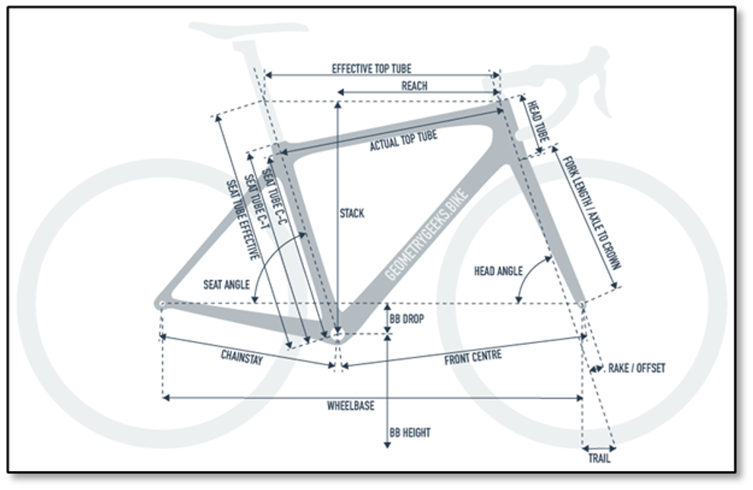
The goal of our project is to determine how many, if any, discrete categories should exist for mountain bikes. Since most specifications and geometric measurements have one direction when moving across the spectrum of bikes, it’s reasonable to believe that these measurements could be reduced to much fewer dimensions, and perhaps even one continuous principal component rather than discrete categories.
Different types of geometric specifications on mountain bikes.

Slide 4
Mountain Bike Categories
Currently, full suspension mountain bikes come in multiple categories:
Cross Country (XC)
Downcou-ntry
Enduro
MTB Categories
All Mountain
Trail

Slide 5
Mountain Bike Categories: XC
Currently, full suspension mountain bikes come in multiple categories:
Cross Country (XC)
Downcou-ntry
Full-suspension cross-country bikes feature steeper geometry than other types of mountain bikes and are designed for pure speed and efficiency. They generally have no more than 120mm of suspension travel, and the suspension design is optimized for efficiency.
Enduro
MTB Categories
All Mountain
Trail

Slide 6
Mountain Bike Categories: Enduro
Currently, full suspension mountain bikes come in multiple categories:
Cross Country (XC)
Downcou-ntry
Enduro bikes are designed to be able to climb up to the top of the mountain but really shine on the way back down. For this reason, they feature more than 150mm of suspension travel and an even slacker frame. The components will all be beefed up to handle the rigors of challenging, rough terrain. If a trail bike is a jack of all trades, then enduro bikes are biased toward downhill performance.
Enduro
MTB Categories
All Mountain
Trail

Slide 7
Mountain Bike Categories: Trail
Currently, full suspension mountain bikes come in multiple categories:
Cross Country (XC)
Downcou-ntry
Trail riding and the corresponding trail bikes refer to what can be thought of as ‘everyday’ mountain bike riding. Trail bikes are designed to have as much fun as possible on any given terrain and be just as capable on the climbs as they are on the descents. Trail bikes have traditionally been thought of as jack of all trades bikes.
Enduro
MTB Categories
All Mountain
Trail

Slide 8
Mountain Bike Categories: All Mountain
Currently, full suspension mountain bikes come in multiple categories:
Cross Country (XC)
Downcou-ntry
A more niche category which some manufacturers claim to be more downhill focused than trail bikes, but not designed for downhill races like Enduro bikes are.
Enduro
MTB Categories
All Mountain
Trail

Slide 9
Mountain Bike Categories: Downcountry
Currently, full suspension mountain bikes come in multiple categories:
Cross Country (XC)
Downcou-ntry
Full-suspension cross-country bikes feature steeper geometry than other types of mountain bikes and are designed for pure speed and efficiency. They generally have no more than 120mm of suspension travel, and the suspension design is optimized for efficiency.
Enduro
MTB Categories
All Mountain
Trail

Slide 10
Data Analysis

Slide 11
Exploratory Data Analysis

Slide 12
Variation Amongst Featureset
The first thing we’ll do is look to see if any of the features in our dataset are better at explaining the variation amongst the different bikes than other features. That is, it’s completely possible that two features are similar and don’t have much variation in them, even across some of the different bike categories. To do so, we’ll:
Look for highly correlated features and flag these for potential removal;
Run Principal Component Analysis (PCA) to see if certain features are better at explaining the variation in our data better than others.

Slide 13
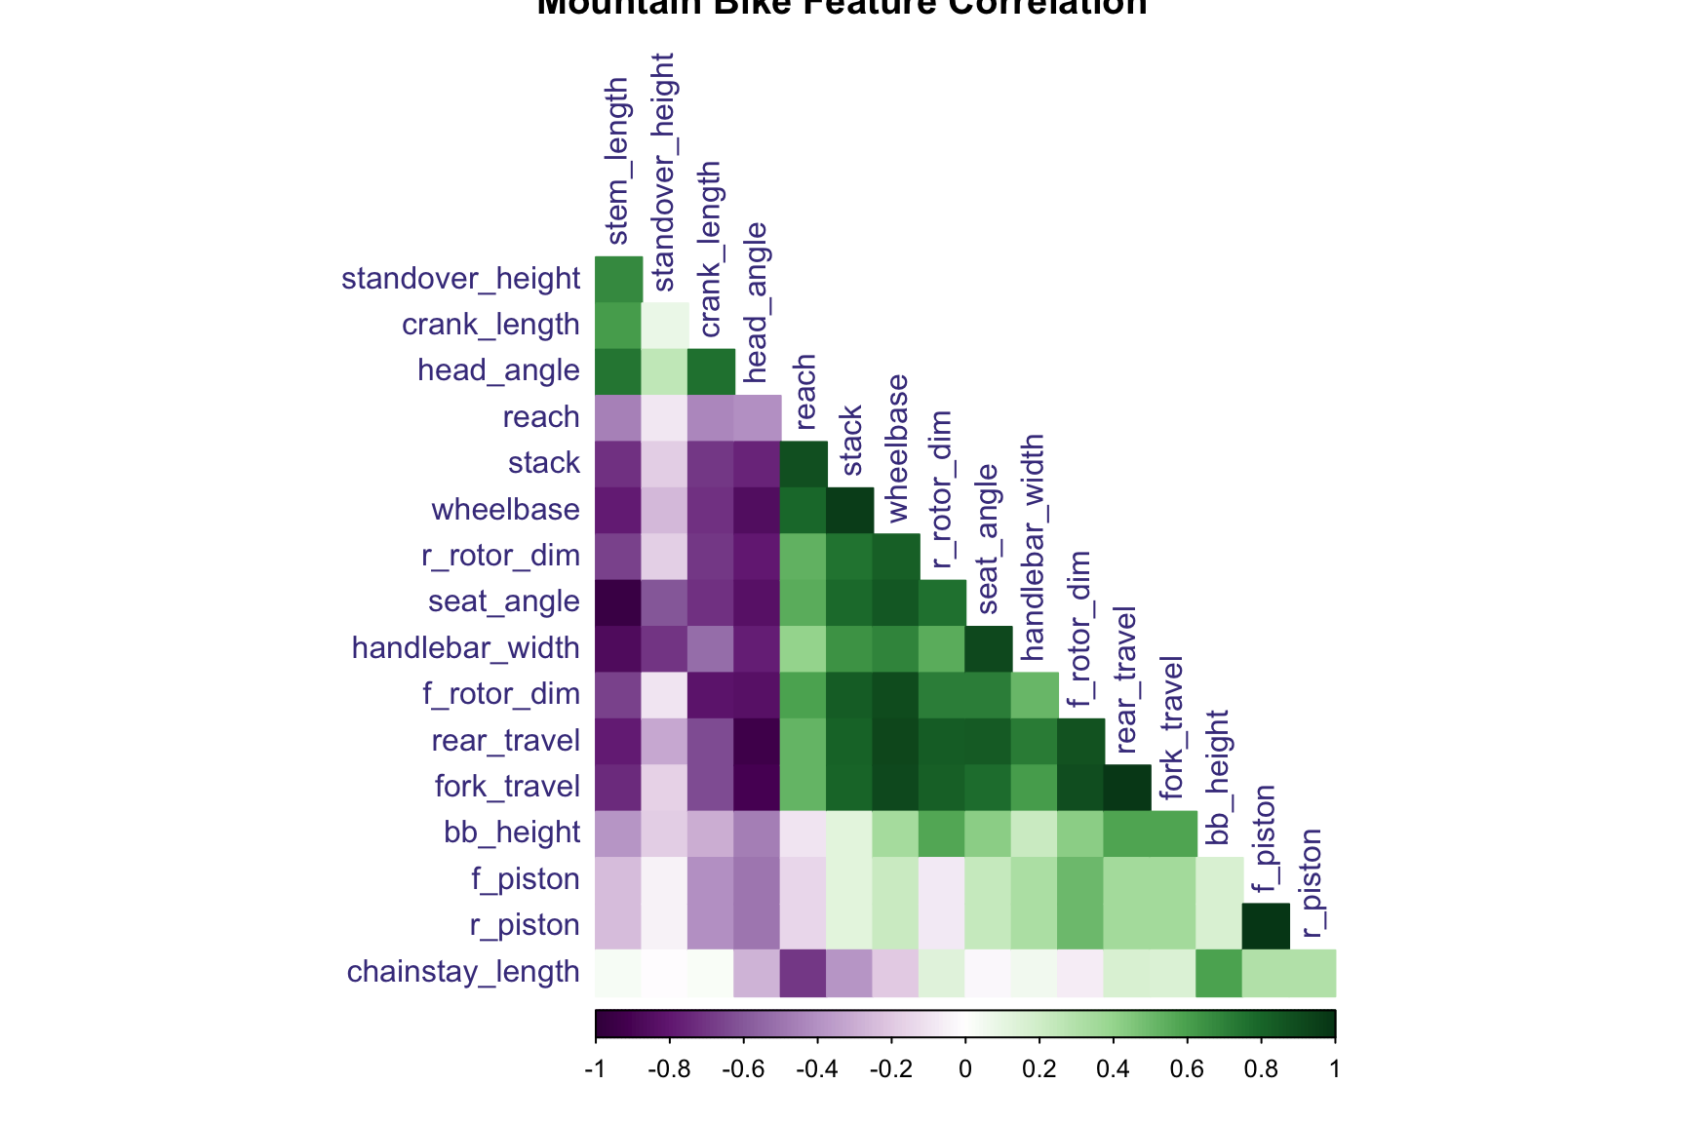
Correlation Amongst Features
Here we see some obvious correlations, for example:
f_piston (front brakes) is perfectly correlated with r_piston (rear brakes), which makes sense since mountain bikes tend to use the same types/spec of brakes for the front vs. rear tires.
fork_travel has a correlation above .95 with: c(“rear_travel”, “fork_travel”). This make sense; for example, rear_travel should be highly correlated with fork_travel.

Slide 14
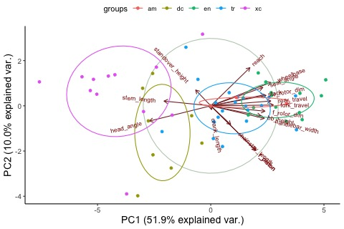
Principal Component Analysis (PCA)
Next, we’ll apply PCA to our dataset. In so doing, we’ll have to center and scale our data given how different the ranges are for certain measurements. To visualize our data, we reduce to 2 Principle components. Let’s take a look at our 4 principal components which explain the largest proportion of variance in the data:
Variable | PC1 | PC2 | PC3 | PC4
Standard Deviation | 3.126 | 1.665 | 1.329 | 1.252
Proportion of Variance | 0.5748 | 0.1631 | 0.1039 | 0.09223
Cumulative Proportion | 0.5748 | 0.7379 | 0.8418 | 0.934
Top 2 Principal Components, shaded by MTB category label.

Slide 15
Unsupervised Learning
Because we are investigating the validity of mountain bike categories, one approach is to treat this dataset as unsupervised, stripping the bikes of their labels.

Slide 16
Unsupervised Learning
Kmeans Clustering
Standard scaled data so that each variable is mean centered with standard deviation = 1.
Measuring goodness of fit using Total Sum of Euclidean Distances from each point to assigned cluster center
Expected decrease in total distance with more cluster centers
Looks to be roughly 3 distinct clusters

Slide 17
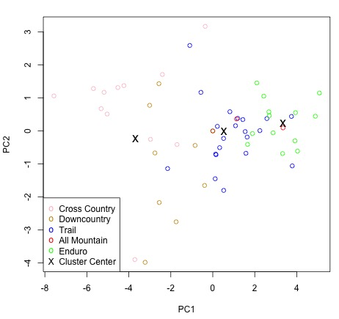
Cluster Centers on Principle Components
Visualizing cluster centers on 2 principle components
‘All Mountain’ category completely overlapped between ‘Trail’ and ‘Enduro’
Bottom two points are Nine brand bikes, which recommended size Medium, thus resulting in lower Reach measurements, which from above we see is a large factor in PC2.

Slide 18
Unsupervised Learning
Gaussian Mixture Model

Slide 19
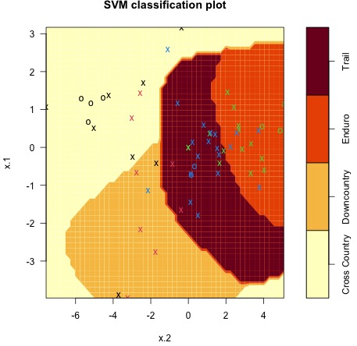
Supervised Learning
If we treat each bike label as truth, then we can model this as a supervised learning problem.
‘All Mountain’ Category combined with ‘Enduro’ due to similarities in initial PCA plot.

Slide 20
Supervised Learning
Support Vector Machine
60% accuracy when treating down country as separate category
77% accuracy when treating down country as XC
65% accuracy when treating downcountry as trail
Suggests that downcountry bikes are more akin to XC than they are trail

Slide 21
Findings/Conclusions

Slide 22
Findings
All results suggest that trying to discretely categorize full suspension mountain bikes is more or less arbitrary.
The categorization of a mountain bike should be treated as a continuous scale, with Cross Country bikes on one end and Enduro bikes on another.
To obtain where a specific bike lies on this scale, one can use the linear combination of the bike’s specifications and the first principle component.

Slide 23
Opportunities for Improved Analysis
There are a few opportunities to improve the analysis included in this presentation and forthcoming report:
Inclusion of more bikes (rows) | More rows = more robust clustering algorithms.
Inclusion of more bike features (columns) | Although we included the most meaningful specs/geometry of the bikes analyzed, there are dozens of other, smaller features that can be used to help differentiate between different types of bikes.
Include all sizes of bikes | We chose to use the size that corresponded to a 5’10” rider, but some bike manufacturers could interpret this as a Medium and others a Large.

